Slide 1
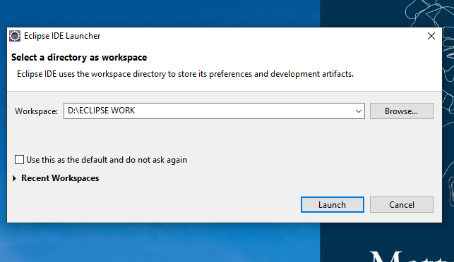
RUNNING JAVA PROGRAM IN ECLIPSE
After opening the Eclipse we will get the workspace dialog box then we should create an empty directory in Local Disk(respective drive) then we should click on launch

Slide 2
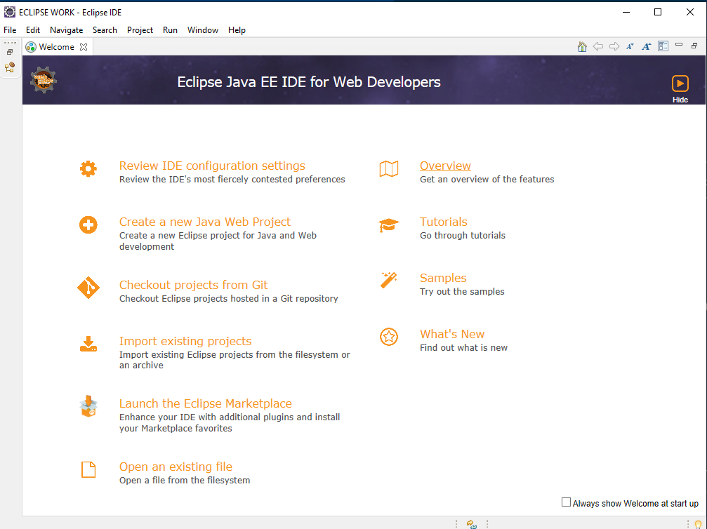
A welcome page will appears to create of our own projects based on our configuration

Slide 3
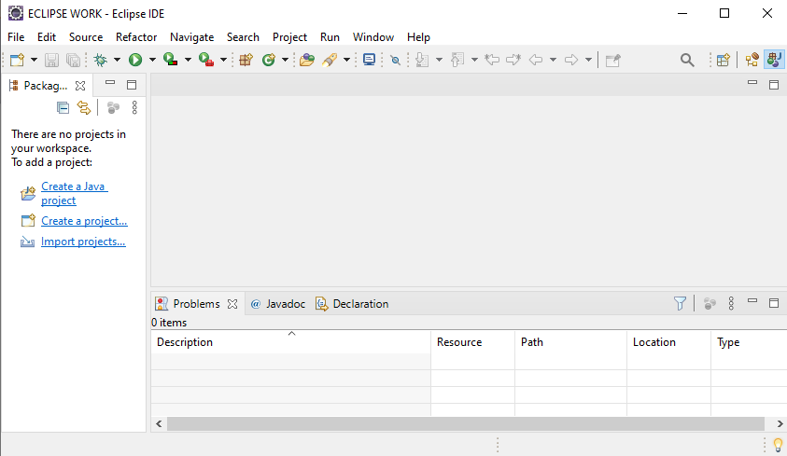
Click on the New we can create our own Java Project

Slide 4
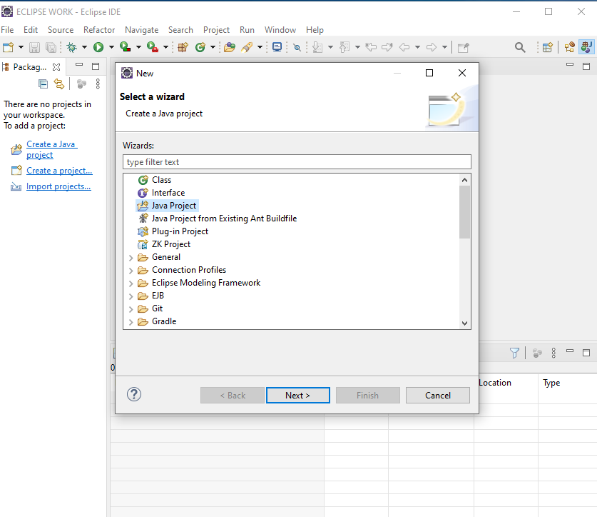
Choose the Java Project in the dialog box which will help to create a new Java Project

Slide 5
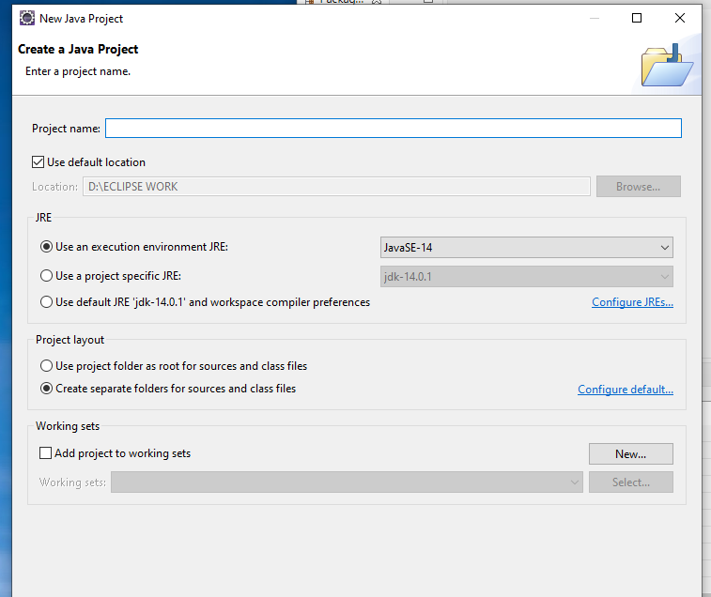
Here we have to write your own Project name and then click on finish

Slide 6
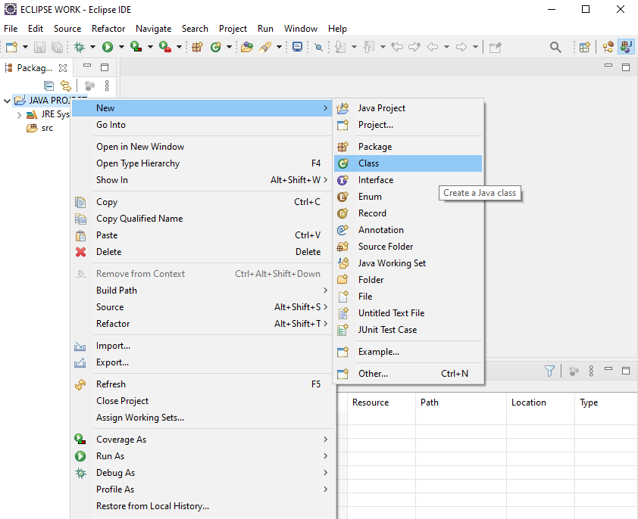
Now left-click on created project then choose new and then choose to create a class for your Java Program

Slide 7
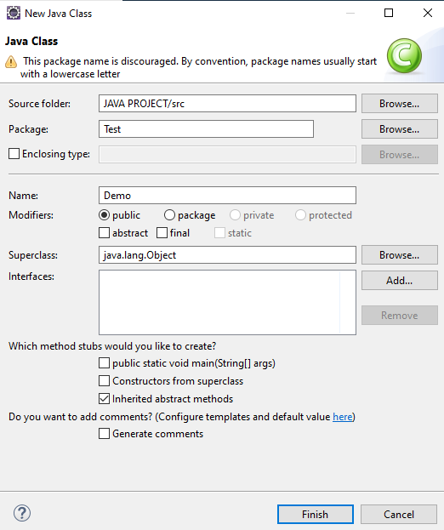
Here we give the Package and also Class Name of your own then we can create our own Java Project
Note:
Class name starting should always be capital.
It is always a best practice to give a Package name for the created class.

Slide 8
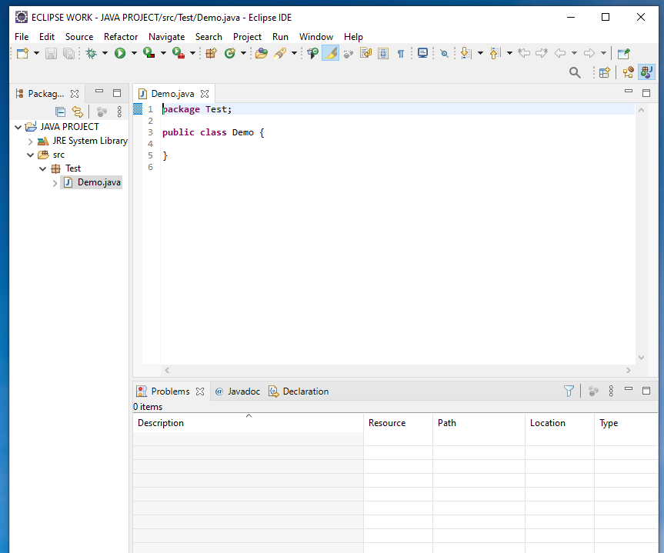
A Class has been created with class name and with a package of your own

Slide 9
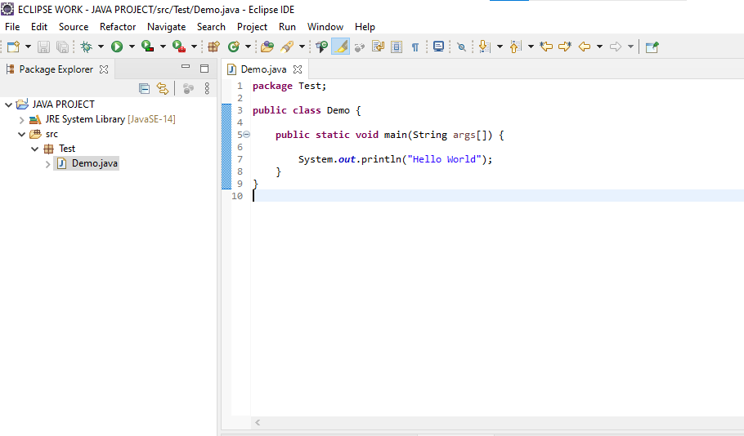
By clicking on the Run button we can execute our program
Here we write the basic hello world Program in it

Slide 10
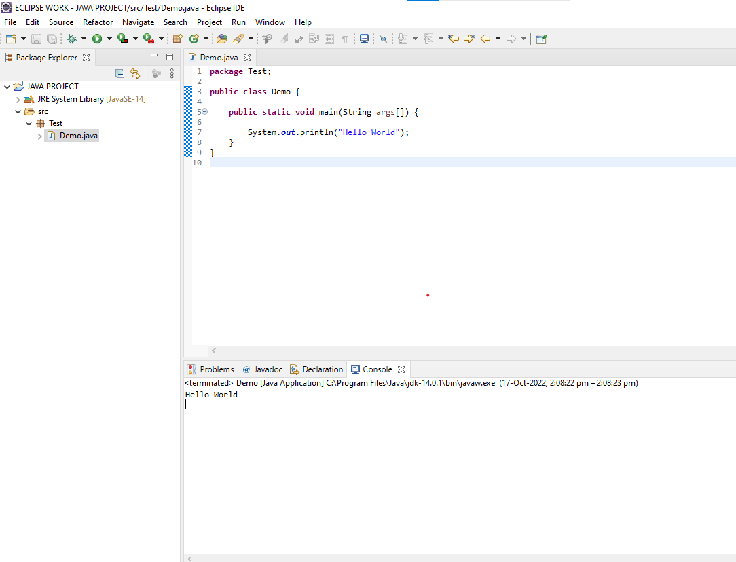
After clicking on run button we can see our Output in the Console Area

